Slide 1

Special Needs Unit (SNU)
Special Arrangements
for students with SpLD and disabilities

Slide 2
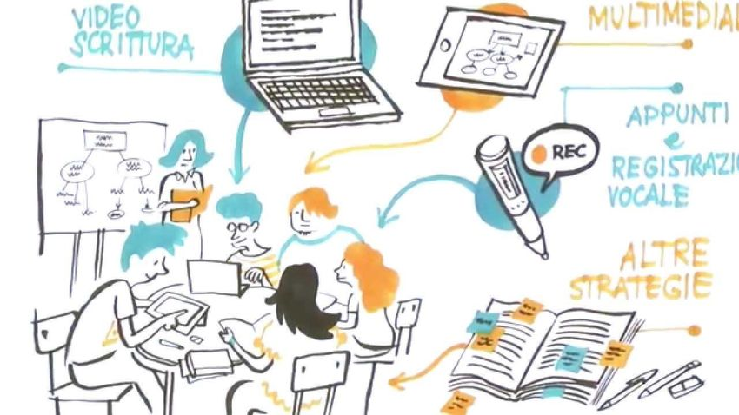

Special Arrangements
Special Arrangements are tools/strategies to allow the overcoming of difficulties related to one's personal characteristics in situations of study and checking of acquired competences.
They are personal, defined for each student by the Special Needs Unit in the first instance on the basis of:
the certification submitted;
the experience of the operators in relation to the specific university environment.

Slide 3
Special Arrangements
study
Educational support | A specific tutoring (educational or sign language) is offered to the student to hepl him/her organize the study process and foster the relationship with the teaching staff
Attention to language | Use linear and direct communication, avoid implicit messages and double negatives in both oral and written intractions
Consulting | Provide frequent and/or periodic indivisual advisory (in-person or remote)
Careful inclusion in group work | During group work: put the student in a small group, supervise the group and foster inclusion
Additional course/examination details | Clearly illustratate the exam structure and explain how to manage the extra time (do not take for granted any basic information on the course)
Lip-reading facilitation | Allow lip reading during the lessons: talk in front of the group, with clear and slow diction or using the microphone
Video lectures | Provide video lectures
Accessible material | Provide accessible learning materials ahead of the lessons (presentations, course handouts, exercise books), if requested by the student
Recorder | Use of recorder
Customised deadlines | Customize deadlines for turning in exercises and projects
Digital texts | Use of digital texts
Video magnifier | Use of video magnifier in the classroom

Slide 4
Special Arrangements
exam (first part)
Authorisation for glycaemic control | Allow the student to keep a glucometer. If the student needs to use it, allow time to resume the exam and give a new deadline to turn in the exam paper
Headphone/noise-cancelling earplugs authorisation | Allow use of noise-cancelling earplugs/headphones and text markers, for in-person exams
HW/SW authorisation | Use of PC /Exam Reader / graphic tablet / speech synthesis ...
Teacher interaction authorisation | Interaction with the teaching staff during the exam, if requested
Exit authorisation | Allow the student to go to the toilet during the exam and give extra time to make up for the toilet break
Calculator | Use of calculator
Legibility criteria | Legibility criteria (Arial, font size 12, line spacing 1,5, unjustified text, expanded spacing)
Care in oral interactions | Carefulness during oral interactions: make sure that the student has understood the question, avoid putting pressure, give more time to process the question and answer it, be patient and wait for the answer
Alternative examination | In the event that a written exam is strictly necessary, check if the exam format (e.g. multiple-choice questions, close-ended questions, etc.) may be a barrier and consider replacing it with a different type of assessment
Online examinations | Possibility to take the exam online (if necessary proctored by the staff of the Special Needs Unit)
SNU space examinations | If requested by the teaching staff/student, the student can take a proctored exam in the rooms of the Special Needs Unit, delivered at the same time of the other students

Slide 5
Special Arrangements
exam (second part)
Formulary | Use of formulary (for both written and oral exams)
Concept maps | Use of concept maps (diagrams that depict relationships between concepts)
Orals quiet environment | Oral exams in a quiet, silent and non-crowded space (or alternatively in the rooms of the Special Needs Unit), with breaks
Oral vs. written | Prefer oral exams rather than written exams
Dedicated workstation | Specific desk / workstation in the classroom or, aternatively, in the rooms of the Special Needs Unit; exam proctored by the SNU staff delivered at the same time of the other students
Tutor presence | A tutor of the Special Needs Unit (a person who reads out the questions and/or helps the student use the PC and/or takes dictation)
Exam division | Exam divided in several modules
Extra time | 30% extra time to take the exam; alternatively, for written exams, a lower number of questions (reduce quantity but not quality)
Enlarged track | Paper-based exam: prepare the exam questions on A3 paper size, font: 14 Computer-based exam: check if it possible to zoom images and adjust brightness
Content vs. form evaluation | Assess content rather than style and spelling
Written legibility check | At the end of written paper-based exams, make sure that the student's answers are legible. If necessary, ask for clarifications of non-legible handwriting

Slide 6

«Watch out for those two!»
Formulary | Use of formulary (for both written and oral exams)
Concept maps | Use of concept maps (diagrams that depict relationships between concepts)
If the form is included among the compensatory measures, you must upload it in the Computerised Reporting Procedure to obtain its validation (well in advance of the examination date and no later than 10 days before the first appeal date of the session).
Concept Maps are a very personal tool, remember to show them to the professors as you make them, bringing them to the classroom and asking for advice on how to structure the various topics: only in this way can you study on a useful material also in the exam, agreed and shared in advance.

