Slide 1
Publishing options: CRUI institution associated corresponding authors

Slide 2
Key information
How do we determine eligibility of the article for the CRUI agreement?
The acceptance date of the article should be on or after the start date of the agreement
The corresponding author must be affiliated with a participating institution in the agreement
The article must be from a participating journal
The article must be associated with the eligible article type

Slide 3
Key information
2. What is the definition of the corresponding author for the purpose of the agreement?
Corresponding author is the author who submits the article to Elsevier and stays in contact with Elsevier in the end-to-end journey
This is the author who makes the publishing choice on behalf of the author group
Every article has one corresponding author

Slide 4
Key information
3. Role of the institutional Librarian/Admin in the Elsevier OA Platform (EOAP)
By the time the article is in your EOAP, we have published the first version of the article in ScienceDirect (within 48 hours of acceptance)
You therefore do not approve the publication of the article; you validate whether the corresponding author can make use of the APC funding under the agreement

Slide 5
Publishing options after acceptance

Slide 6
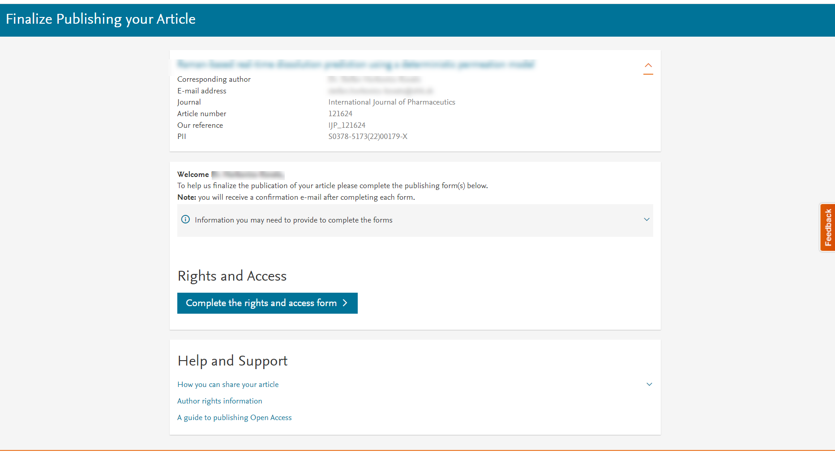
Corresponding author receives an email post acceptance with a unique link to complete the author journey and choose publishing options
Author clicks on Complete the Rights and Access information form

Slide 7
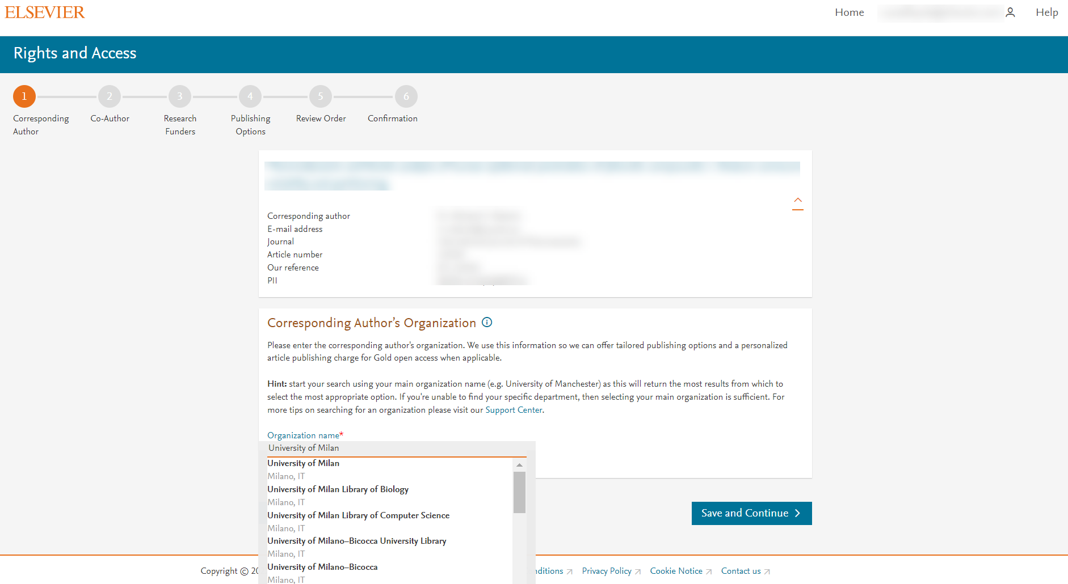
Corresponding author selects his/her affiliation details which we use to identify the authors and match them to the CRUI agreement
Please note that the author has already provided this information at submission; it is prepopulated

Slide 8
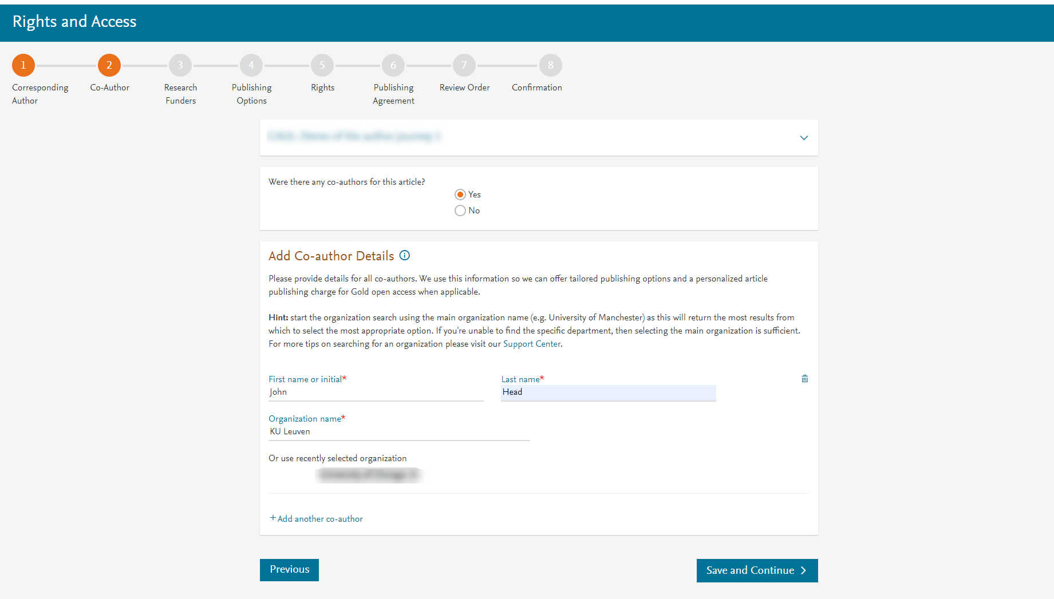
Corresponding author also adds the co-author affiliation details

Slide 9
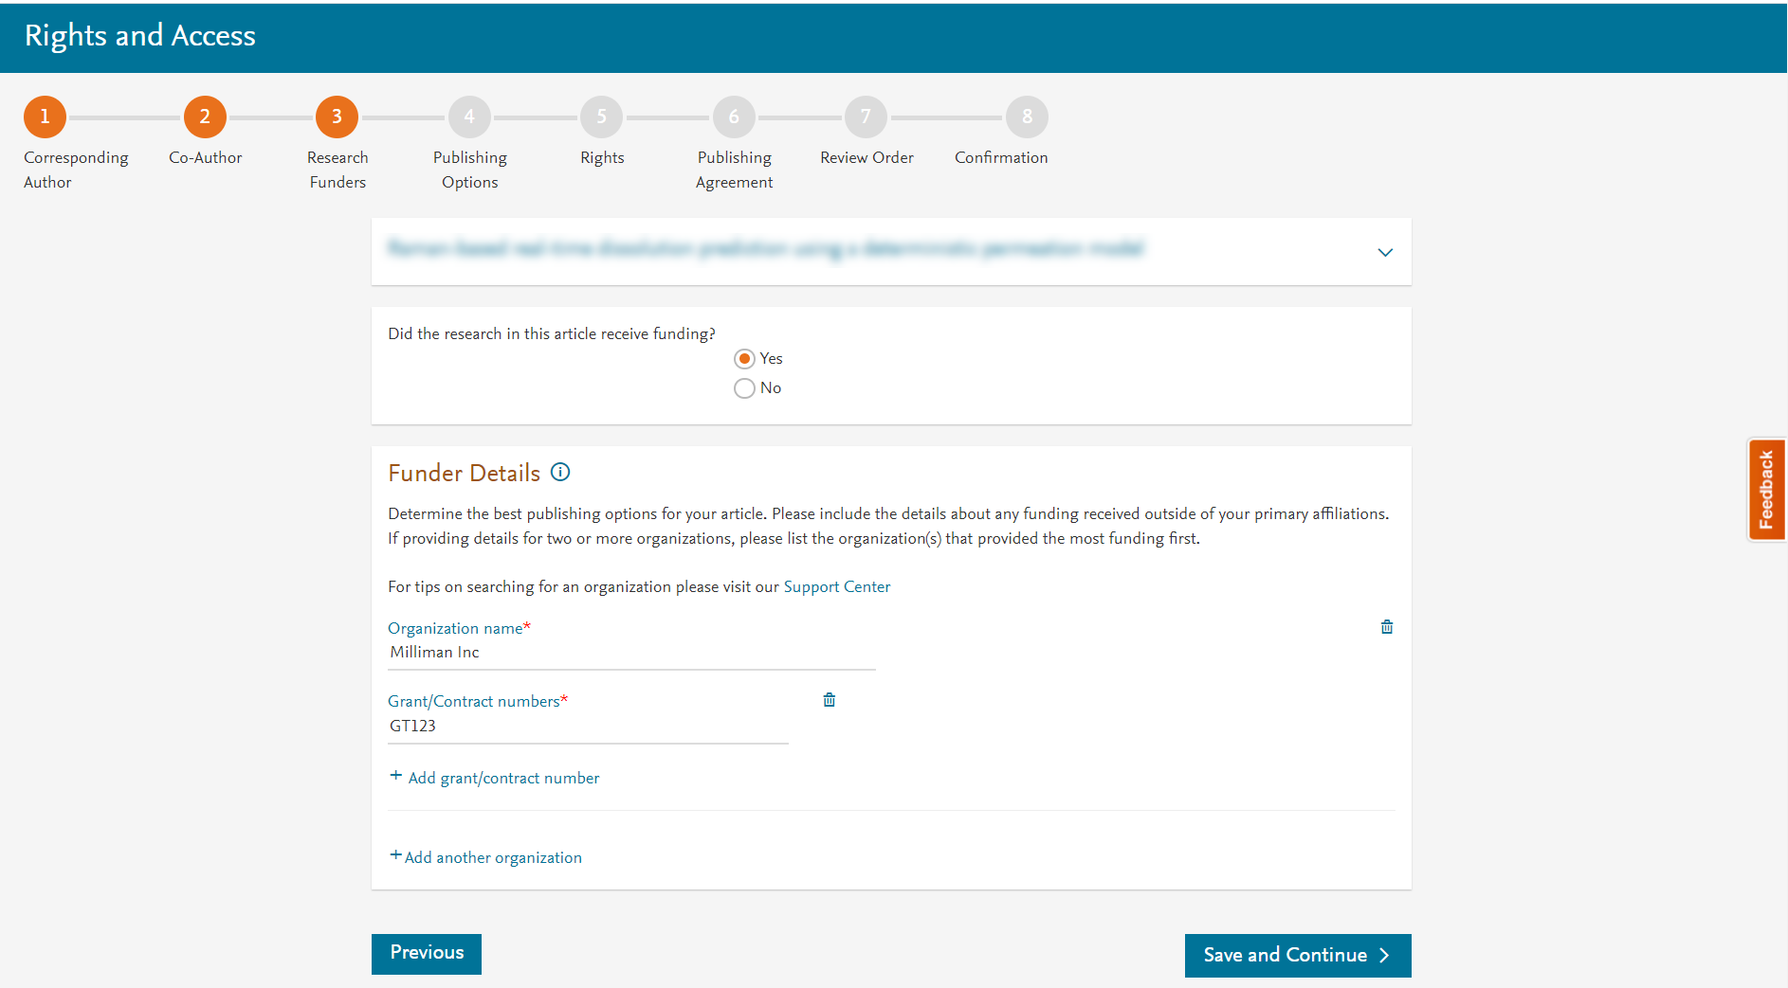
Author can add the Funder details. Funder can be the affiliated institution or a different one. In this case it is Milliman

Slide 10
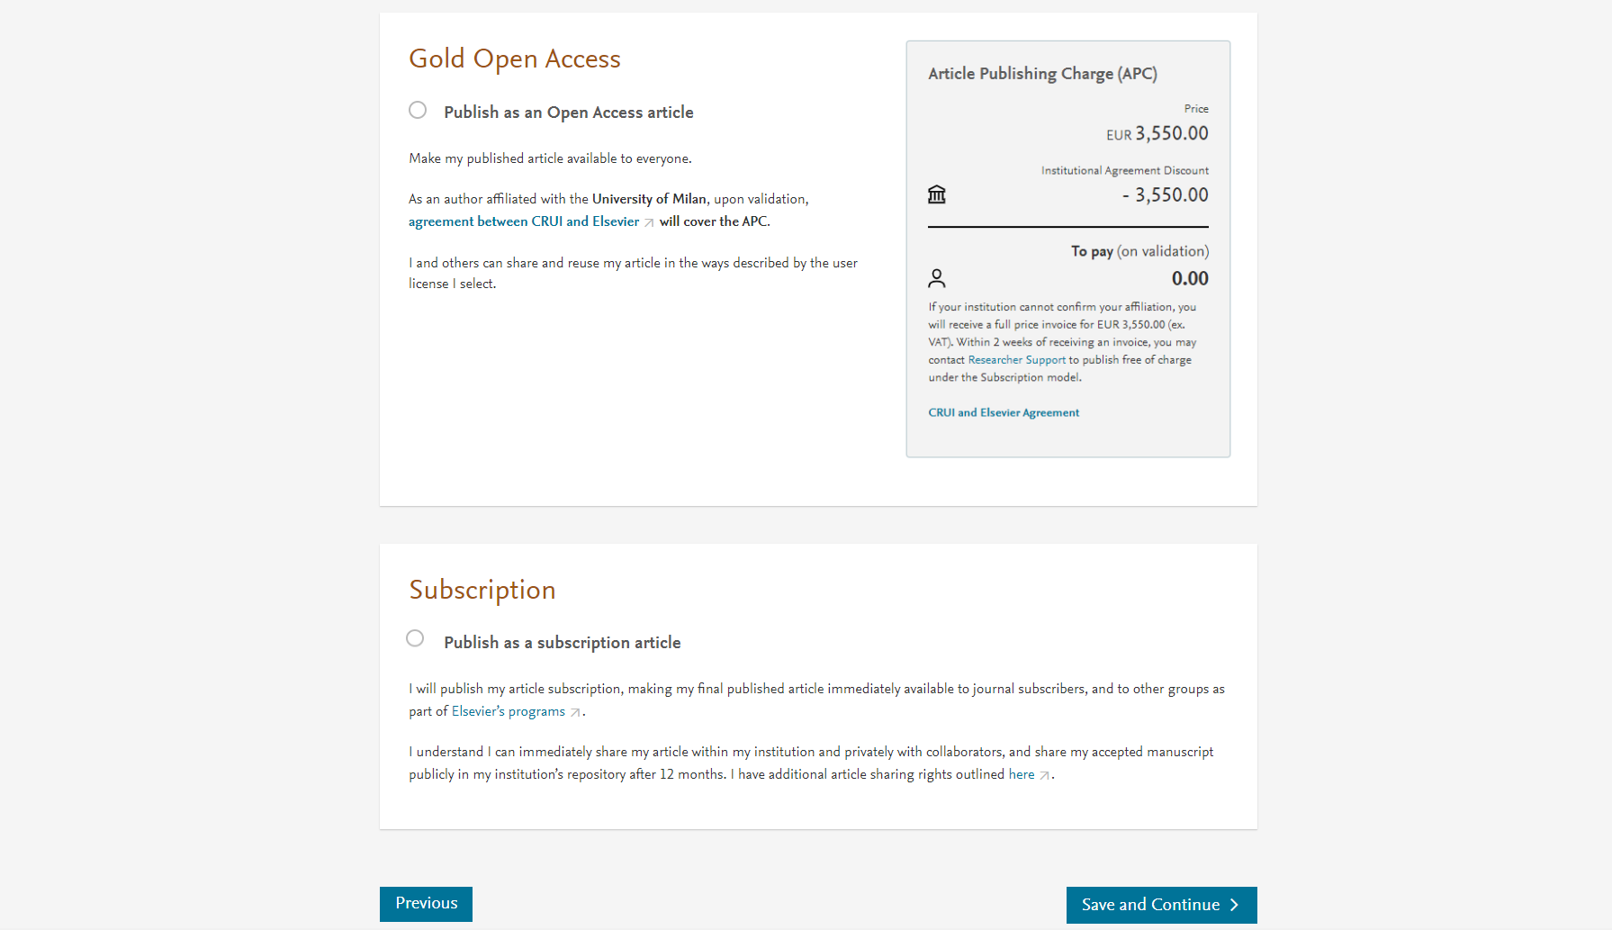
In hybrid journals, the author sees the Publishing Options based on the affiliation details provided. Gold OA option is followed by Subscription option, and we inform the author that agreement covers the APC
If the librarian/admin at the institution rejects the author request in the Elsevier Platform, we also make it clear that the authors will receive a full price invoice
Author selects Gold OA

Slide 11
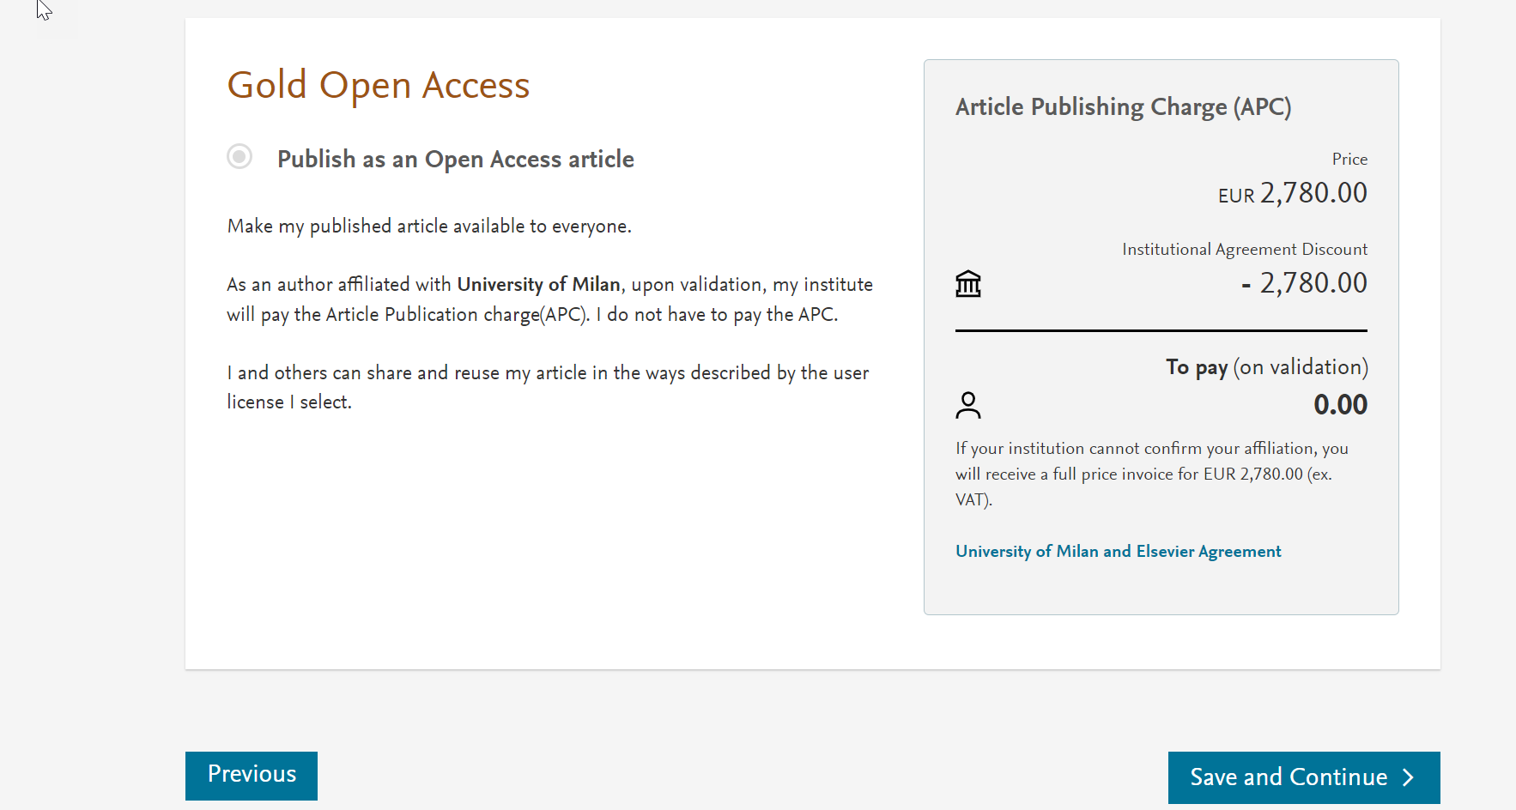
In case of Gold OA journals, author sees only the Gold OA publishing option and we inform the author that institution covers the APC
If the librarian/admin at the institution rejects the author request in the Elsevier Platform, we also make it clear that the authors will receive a full price invoice

Slide 12
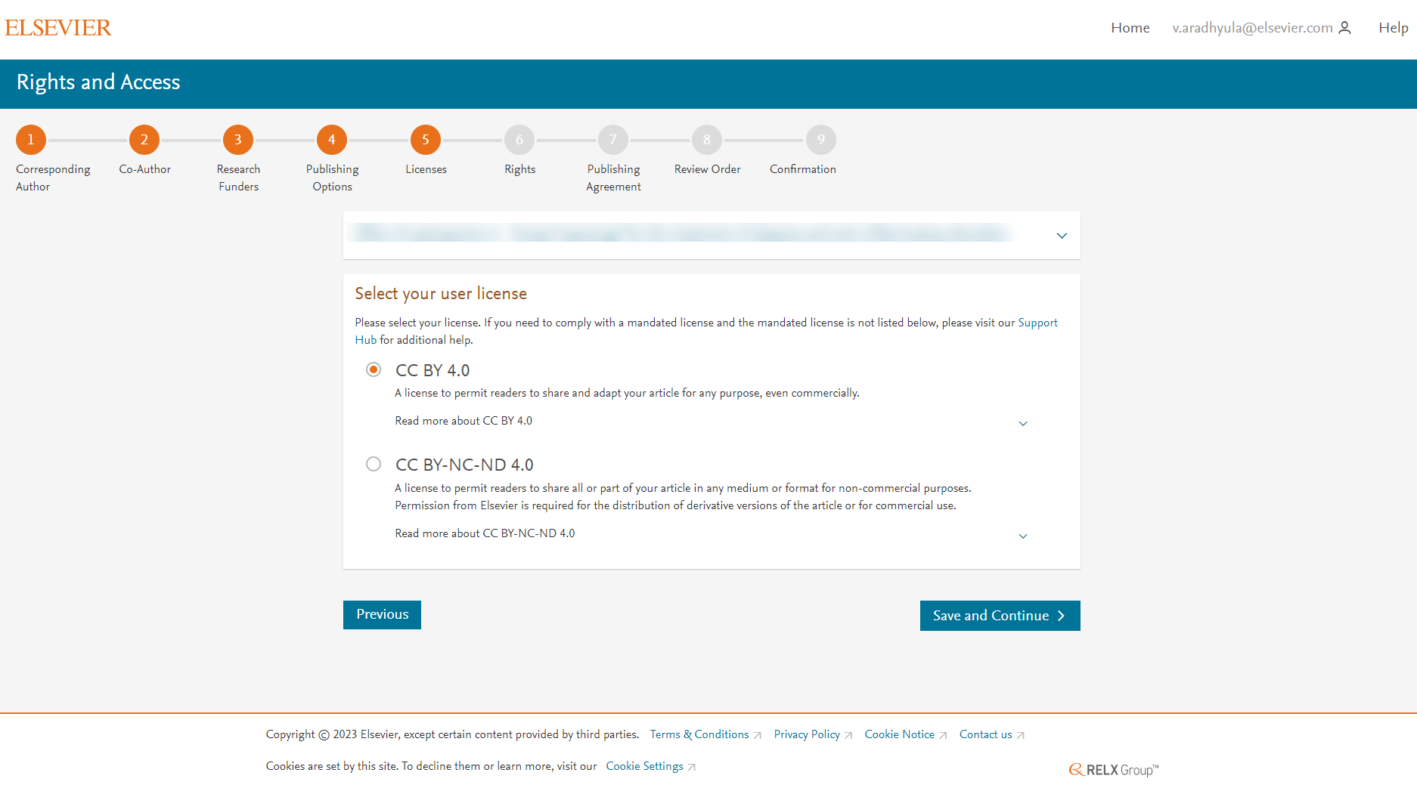
System presents the author with the CC license options
CC BY option is pre-selected

Slide 13
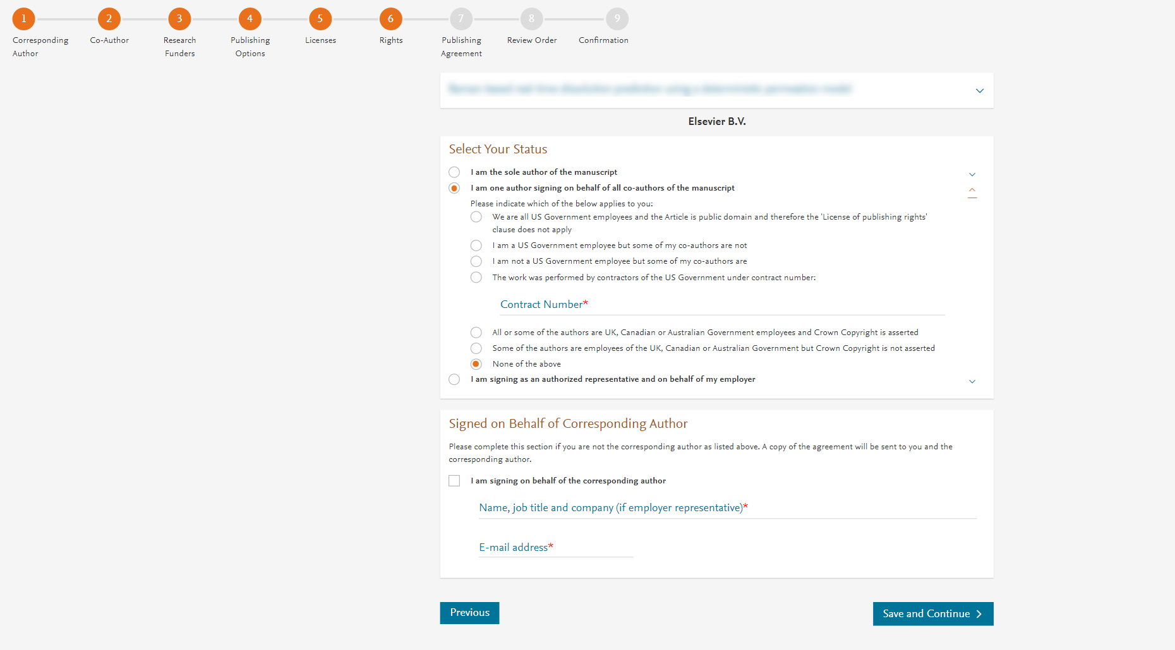
Author selects the rights

Slide 14
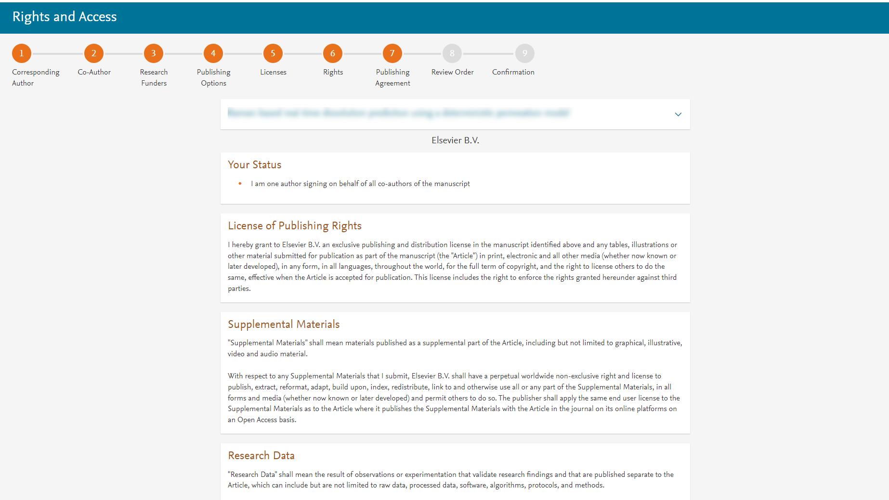
System presents author with the Journal License Publishing Agreement

Slide 15
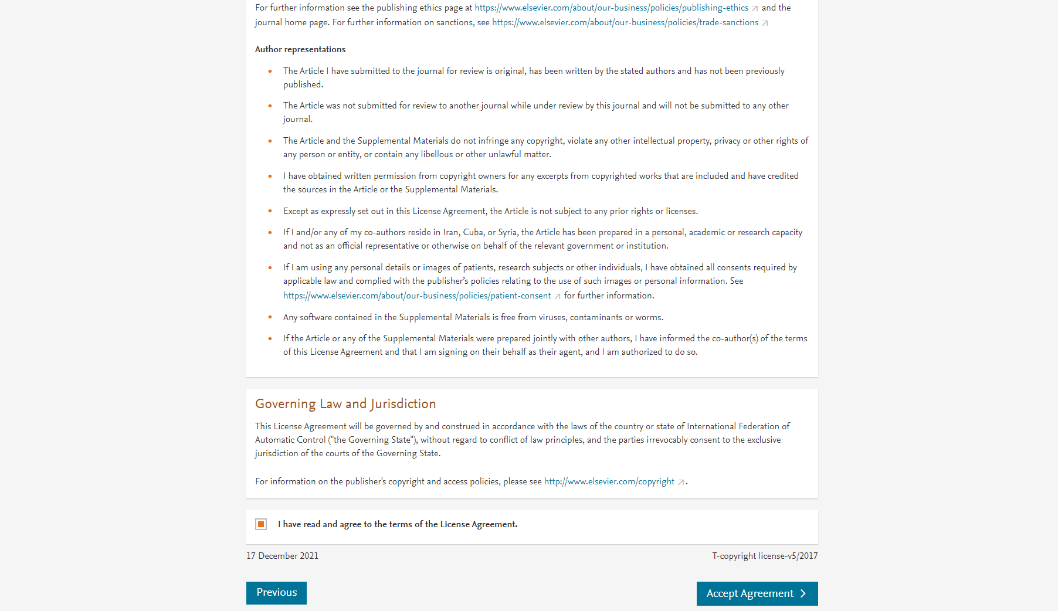
Author agrees to the Journal License Publishing Agreement

Slide 16
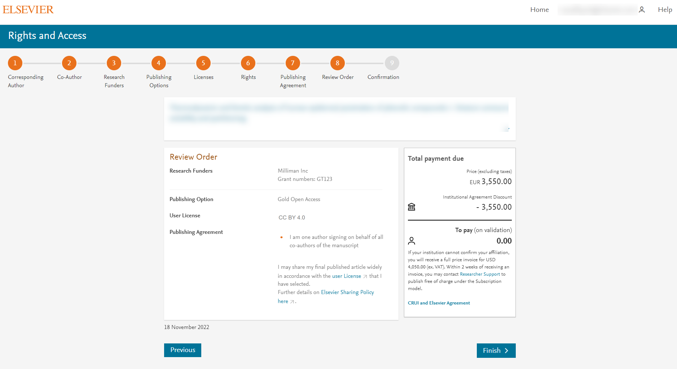
Once the author clicks on ‘Finish’:
Corresponding author and coauthors receive a copy of summary via email
Article becomes OA on ScienceDirect within 24 hours
Librarian/admin at the institution will receive a notification for validation within 48 hours who then has 3 weeks to validate the request
If the Librarian/admin approves the request, the author will receive the full APC coverage
If the Librarian/admin rejects the request, the author will receive the full price invoice
In case Gold OA journal, the author will see the following text.
“If your institution cannot confirm your affiliation, you will receive a full price invoice for USD 4,050 (ex VAT).”

Slide 17
Support for authors and librarians/admins
Author queries – support@elsevier.com
Author journey videos: https://service.elsevier.com/app/answers/detail/a_id/29789/supporthub/publishing/track/APN2ZgoIDv8a~RNiGvwa~yKgpv0qOS75Mv9e~zj~PP_X/

